Slide 1
Filter Selection in YOLOv3 for Object Tracking Efficiency Enhancement
By Yun Chen
Supervised by Professor James J.Clark
Master of Engineering (Non-Thesis)
Electrical and Computer Engineering
McGill University
Notes:
Hello, my name is Yun Chen and I am a master student under the supervision of Professor James Clark in Electrical and Computer Engineering Department at McGill University. I would like to thank two professors which have been important during my master’s degree. And coincidently they are the judges who sit there. The first one is my supervisor, who has provided his great patience and help during my master’s degree. Also, he helped me to get a great chance to do internship and research, from which I have really learned so much. Another one is Professor Tal Abel, although I did not do it well academically in her course, I actually have learned a lot about how to hold a more curious and precise attitude towards scientific problems. Today I am going to present my project, which is titled: Filter selection in YOLOv3 for object tracking efficiency enhancement.

Slide 2
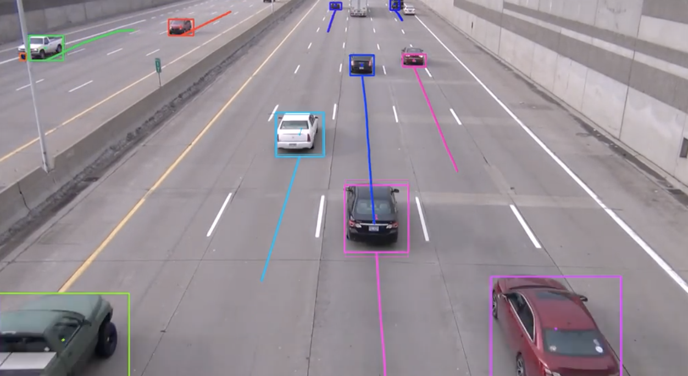
Introduction
Object tracking is an important topic in computer vision
Information can be gathered such as motion states, motion trajectories and interference between objects
Intelligent machines make better decisions
Crucial for traffic surveillance
Notes:
Object tracking is a very important topic in computer vision. The idea of object tracking is to track multiple objects simultaneously. A lot of information can be gathered after object tracking such as motion states of objects, motion trajectories, and interference between objects. Intelligent machines can make more reliable decisions based on the results of object tracking. Object tracking has been applied in various applications such as autonomous driving, traffic surveillance, etc.

Slide 3
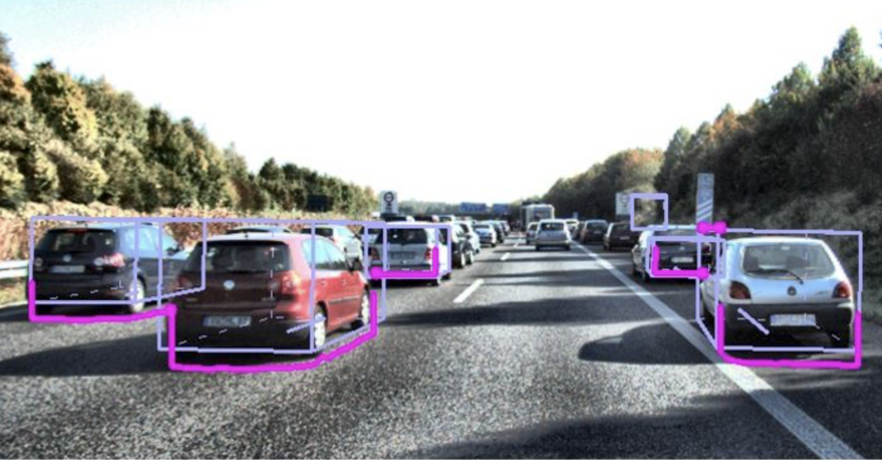
Problem
When the lighting condition is poor
Object detection accuracy drops
When two objects in the same class are together
It is hard to differentiate
Notes:
Most of the object tracking techniques use object detection first. And then, the results of object detection such as object classes and the bounding boxes are gathered with other sources of data such as optical flow to perform object tracking. However, object tracking can never be perfect. When the lighting condition or weather condition is poor, the object detection accuracy drops because it is harder to detect an object at this time. When the objects are occluded due to some occlusions, it is hard to differentiate them after they appear again. These situations all affect the object tracking efficiency. So can we solve them and enhance the efficiency of object tracking?

Slide 4
Solution
We need extra features that can represent various objects in the same class
Notes:
One natural thought is to find a new type of feature. Each feature can represent each object. For various objects in the same class such as cars or pedestrians, these features can differentiate them successfully so that object tracking efficiency will be enhanced.

Slide 5
How?
State- of-the-art object detection system: YOLOv3
Only last-layer outputs are used
We want to extract new features from previous layers of YOLOv3
Notes:
Based on this thought, we decide to develop new features to represent various objects. But how? Let’s look at the state-of-the-art object tracking system. Most of them are based on the object detection first to get object classes and bounding boxes, and YOLOv3 is the state-of-the-art deep learning object detection method. As we only use the last-layer outputs to represent objects before, we hope to exploit the whole convolutional neural networks so that more information about objects can be extracted and used for us.

Slide 6
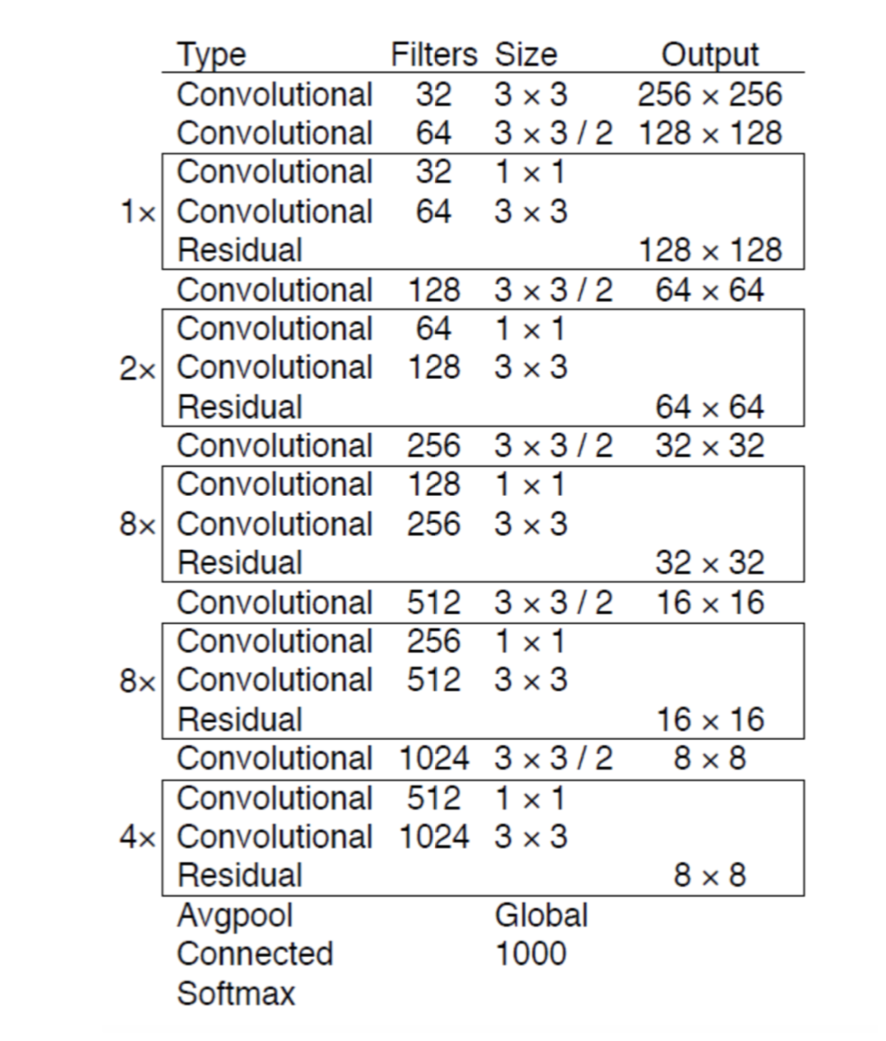
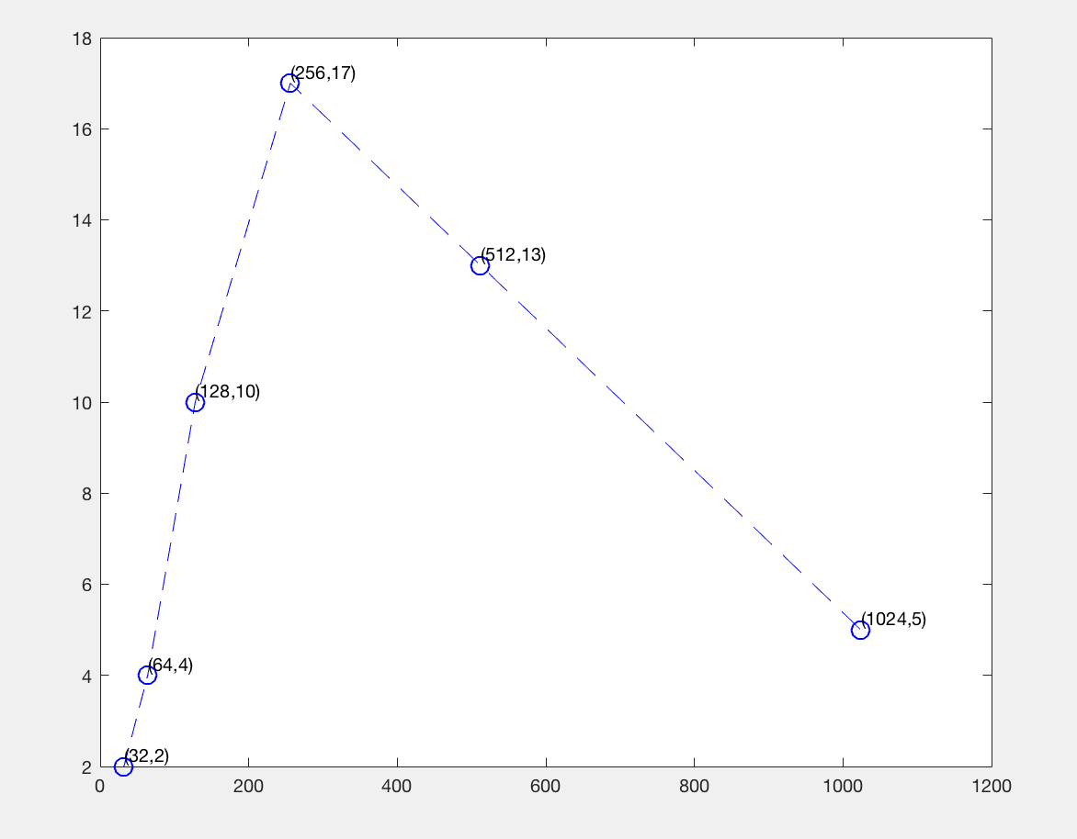
YOLOV3 feature extractor: Dartknet-53
Structure
Layers: 6 categories
Notes:
Let’s look at the structure of Yolov3. The feature extractor in YOLOV3 is called Darknet-53. It is a 53-layer convolutional neural network. Except for residual layers, average-pooling layer and fully-connected layer, the layers of Darknet-53 can be divided into 6 categories by the number of filters each layer contains. We can see that there are 2 layers that contain 32 filters, 4 layers that contain 64 filters, 10 layers that contain 128 filters, 17 layers that contain 256 filters, 13 layers that contain 512 filters, 5 layers that contain 1024 filters. In a word, in each layer, there are at least 32 filters and at most 1024 filters. Through calculation, the number of all filters in all layers is 17,728, which is a huge number.

Slide 7
How to select from the huge number of features inside YOLOv3?
The number of all filters in all layers is 17,728, which is a huge number.
The number of output features in each filter varies from 8*8, which is 64 to 256*256, which is 65,536.
Notes:
The number of all filters in all layers is 17,728, which is a huge number.
The number of output features in each filter varies from 8*8, which is 64 to 256*256, which is 65,536.
With such huge numbers inside of various layers of YOLOv3, how should we select them to better represent objects? How to select them so that object can be more distinguished?

Slide 8
New algorithm
Based on
Filter Selection Algorithm
Activation level
Notes:
In order to solve the problem, I developed a filter selection algorithm to select some filters. Assume that for various objects in the same class such as cars, various filters have different activation levels. Assume that some filters might be more useful and other filters does not work so much, these less useful filters might be redundant, Why don’t we just choose the filters that are more useful and contain more information so that they can be used to represent objects? Based on this assumption. We have another problem: how to define which filter is more useful than others to represent different objects in the same class? Let’s look at the activation levels.

Slide 9
Activation level in CNNs
Each filter in each layer
⍬ denotes the parameters of CNNs (weights and biases)
h_{ij}(⍬, x) denotes the activation level
Notes:
For each filter in each layer, ⍬ denotes the parameters such as the weights and biases of the convolutional neural networks, x is the input such as image pixels, the output of each filter denote the activation level. In YOLOv3, the output of each filter is a tensor. The values inside of the tensor can be positive or negative, we calculate the absolute value and then sum them all, divide by the tensor size. For each filter, we get a value as the activation level.

Slide 10
Filter selection algorithm
Since each filter gets an activation when input an image
For a series of images in the same class, if the filter is more activated, the filter is the one that has learned more patterns
Likewise, if the activation level of filter on the whole image dataset gets more variations, it can be used as better filters with features to differentiate various objects in the same class
We choose filters with highest variations and high or medium means on the whole image dataset
Notes:
So these are the steps of filter selection algorithm: since each filter gets an activation value when input is an image, for a series of images in the same class, if the filter is more activated, the filter will be the one that has learned more patterns. Likewise, if the activation level of filter on the whole image dataset gets more variations, it can be used as better filters with features to differentiate various objects in the same class. In this way, we choose filters with highest variations and high or medium means on the whole image dataset.

Slide 11
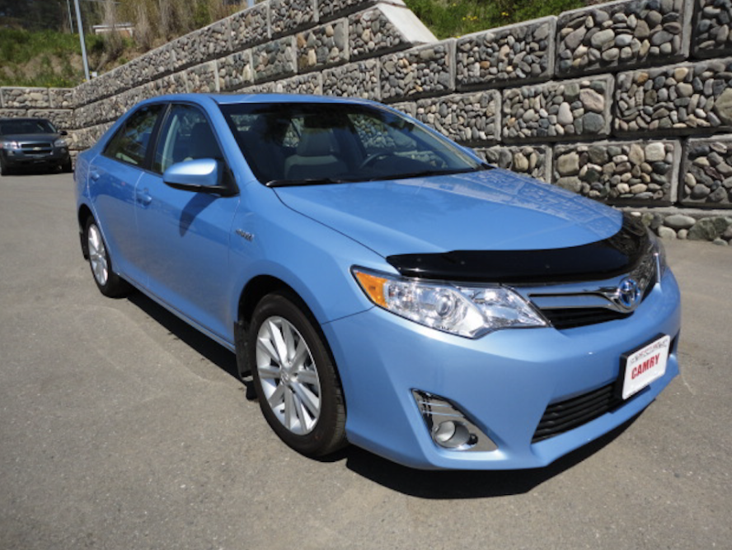
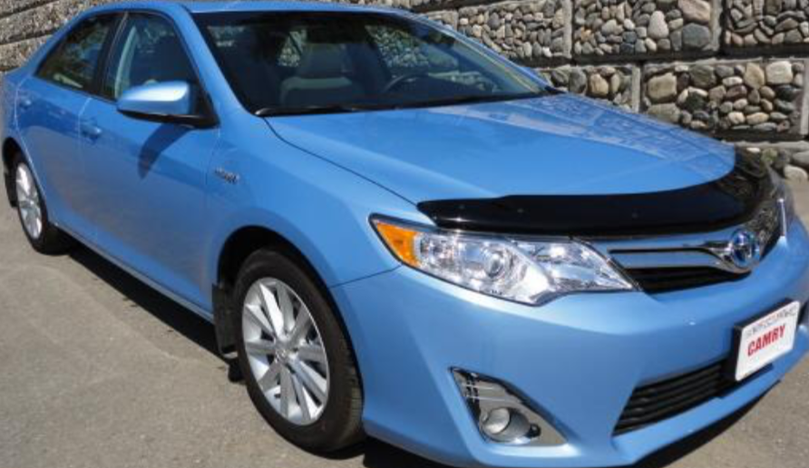
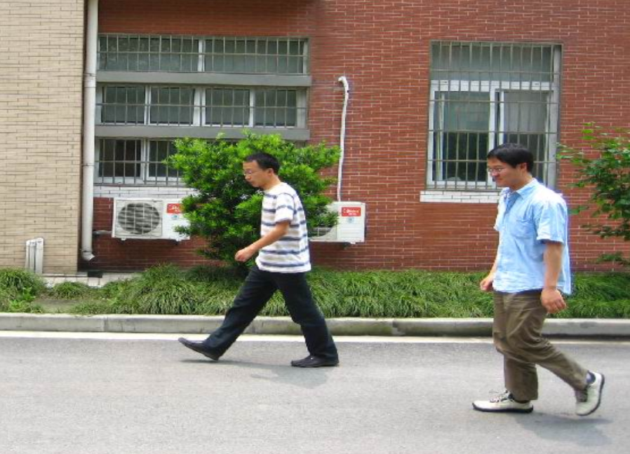
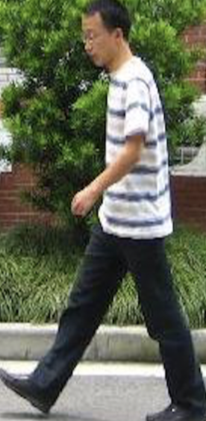
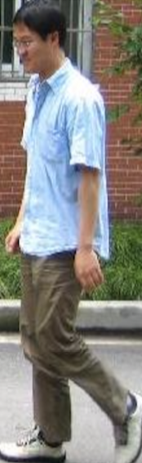
Experiment: dataset
Two datasets: cars and pedestrians
Cropped and 99 images are fed as input
Each input image contains a car or pedestrian
Notes:
For the experiment, two datasets are chosen. They are car and pedestrian dataset. Since the background such as the stone walls in the car image and the windows or the road in the pedestrian image might influence our result. We do not want to choose filters that have high activations on walls or windows, so we cropped these images. Altogether, 99 images are fed into YOLOv3 as input dataset. Each input image contains one car or pedestrian.

Slide 12
Experiment
Calculate the filter activation on one image: 6s
Calculate the mean and variance of filter activation on dataset: 10 minutes
17,728 filters altogether: 123 days to go through one dataset
25 filters in conv_1, conv_30,conv_70 are calculated respectively
3 filters in each layer chosen
75 filters altogether calculated, 9 filters chosen
Notes:
It takes around 6s to calculate the filter activation level on one image. Thus, it takes 10 minutes to calculate the mean and variance of one filter activation on the whole dataset. Since there are 17,728 filters altogether in YOLOv3, it will take 123 days, which is around 4 months if we go through all the filters. It is impossible, so we choose 3 layers. The three layers represent the first layer, which is conv_1, the middle layer, which is conv_30, and the last layer, which is conv_70 in YOLOv3. The first 25 filters are calculated and 3 filters are chosen in each layer.

Slide 13
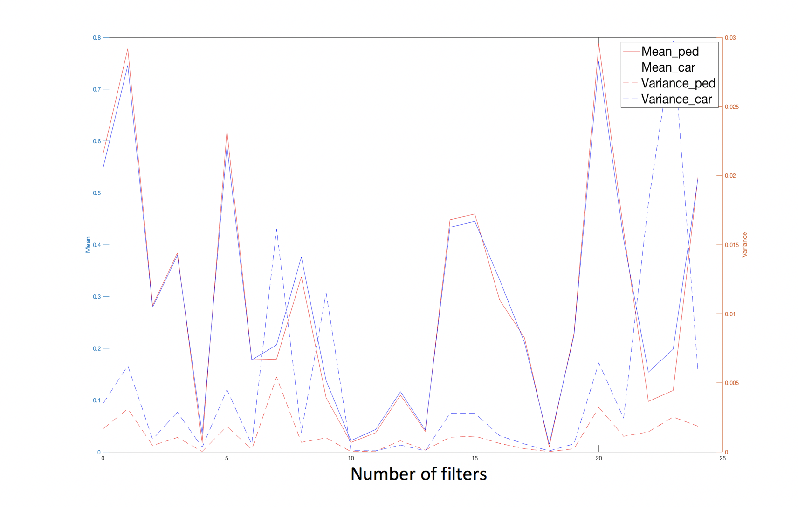
Results: conv_1, Filter 7, 9, 23 are chosen
Notes:
This is the result of conv_1, conv_30, and conv_70. The dashed lines of blue and orange color are variances of filters on cars and pedestrian datasets respectively. The straight lines of blue and orange color are variances of filters on cars and pedestrian datasets respectively. Firstly, we have some findings.

Slide 14
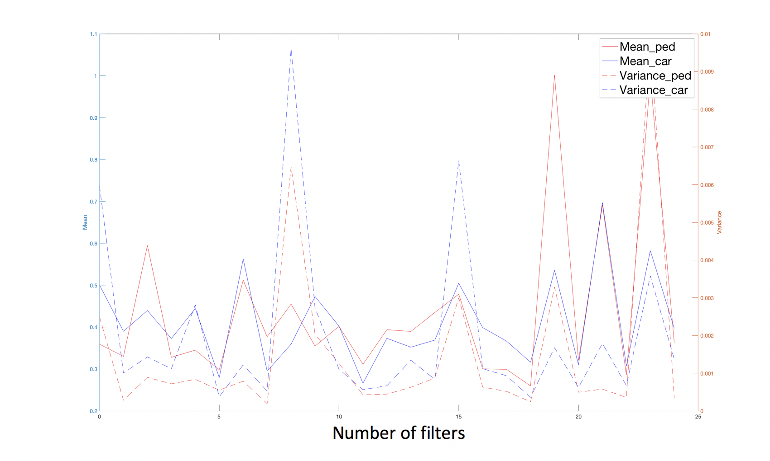
Results: conv_30, Filter 8, 15, 24 are chosen
Notes:
From the 3 images, we can see that the variances and means of filters on both datasets have the same trend. For one filter, if it has high means on cars, it will have high means on pedestrians too. If it has high variances on cars, it it will also have high variances on pedestrians.
We can see from the 3 images that the variances of filters on car dataset are almost always bigger than the pedestrian dataset. It is obvious because the car images have more variances based on color, length, shape, and textures of cars, but for pedestrian images, there are less variations compared to various cars.
The mean activation levels on cars and pedestrian datasets are similar and do not have huge difference.

Slide 15
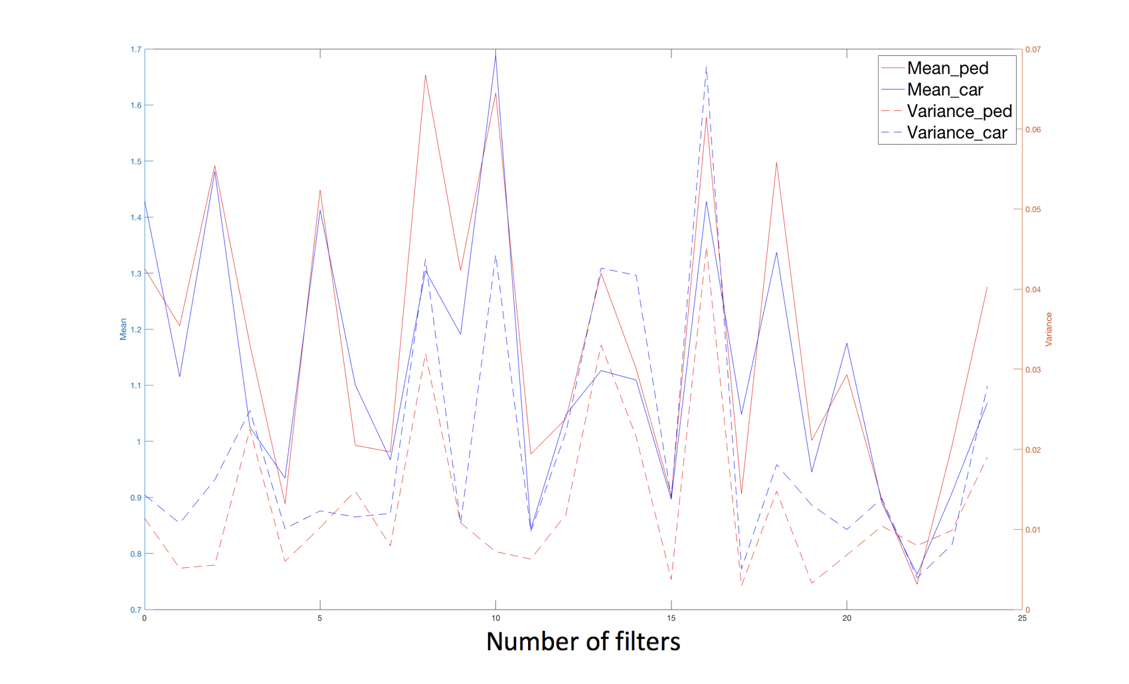
Results: conv_70, filter 8, 13, 16 are chosen
Notes:
So in order to choose better filters, we choose filters with highest variances and high or medium means. Because it is more important for the filter to differentiate various objects in the same class. If the variance of the filter is high on dataset, it means the filter will have different responses on various objects in the same class. We want to choose filters with high or medium means because we cannot choose filters that have low means of activation levels, which indicate that the filter is not sensitive and does not response at all.
So in the end, 9 filters are chosen, they are:…

Slide 16
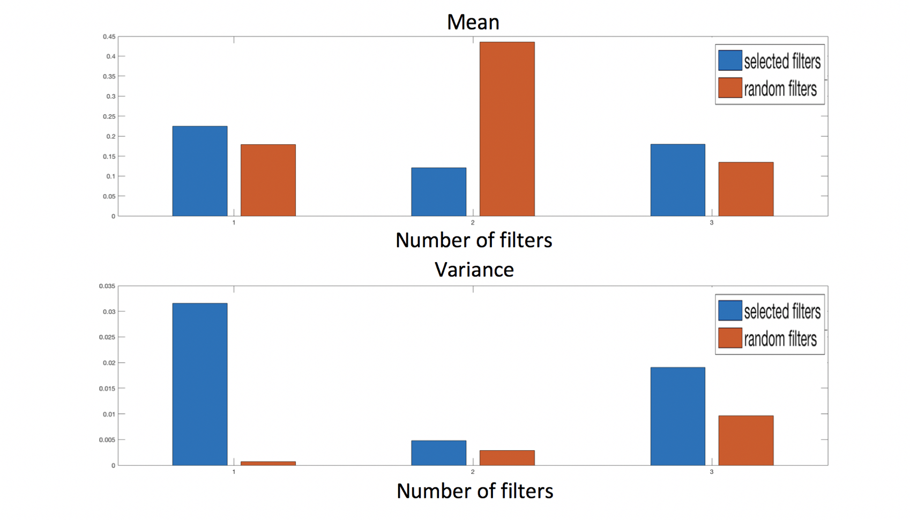
Cars testing results: conv_1
Notes:
In order to test our algorithm and our selected filters, a testing experiment is designed. 3 filters are randomly selected in each layer. 9 filters are randomly selected altogether to compare with our selected useful filters. Furthermore, 2 testing dataset that contain 30 car or pedestrians are used in our testing algorithm. Therefore, the means and variances of random filters and our selected filters are calculated and compared on cars and pedestrian datasets. The first 3 images are results on conv_1, conv_30, conv_70 of car datasets, and the latter 3 images are results of pedestrian datasets.

Slide 17
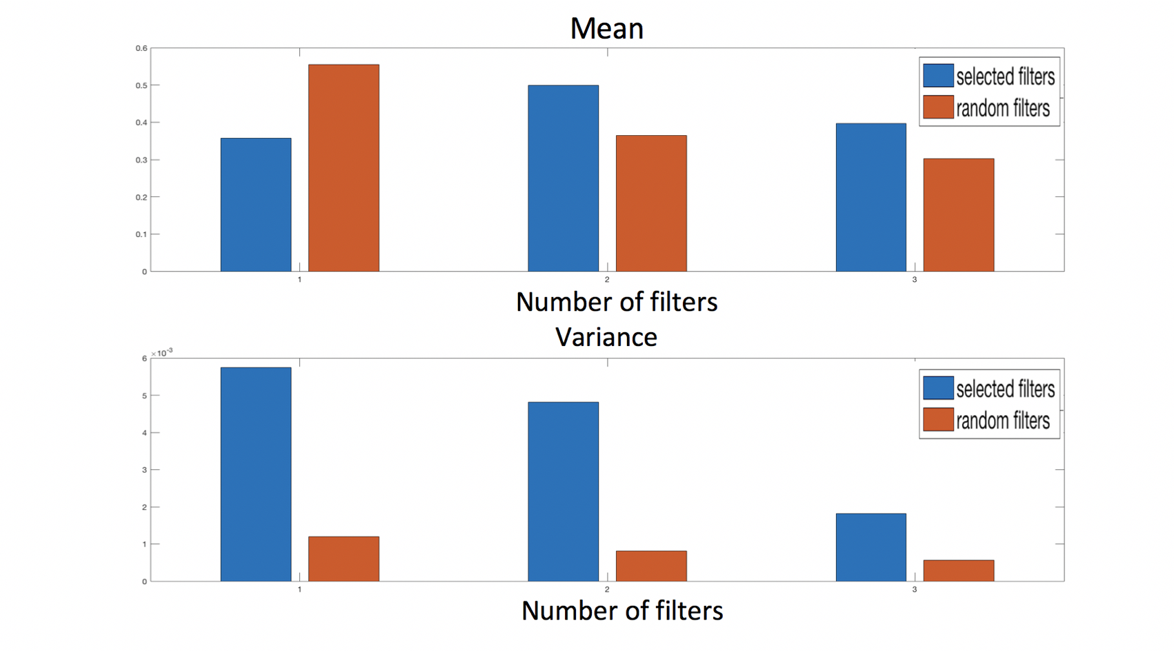
Cars testing results: conv_30
Notes:
The blue bars represent selected filters by algorithm, and the orange bars represent filters selected randomly. The upper figure is the mean values and the lower figure is the variance value.
We can see that for the lower figures, the height of blue bars are always higher than orange bars, which means that variances of selected filters by algorithm are all bigger than randomly selected filters.
For the upper figures, the height of blue bars and orange bars are similar, most of the time the blue bars are higher than orange bars, indicating that the mean values of activation levels from selected filters by algorithm is higher or similar to random selected filters.

Slide 18
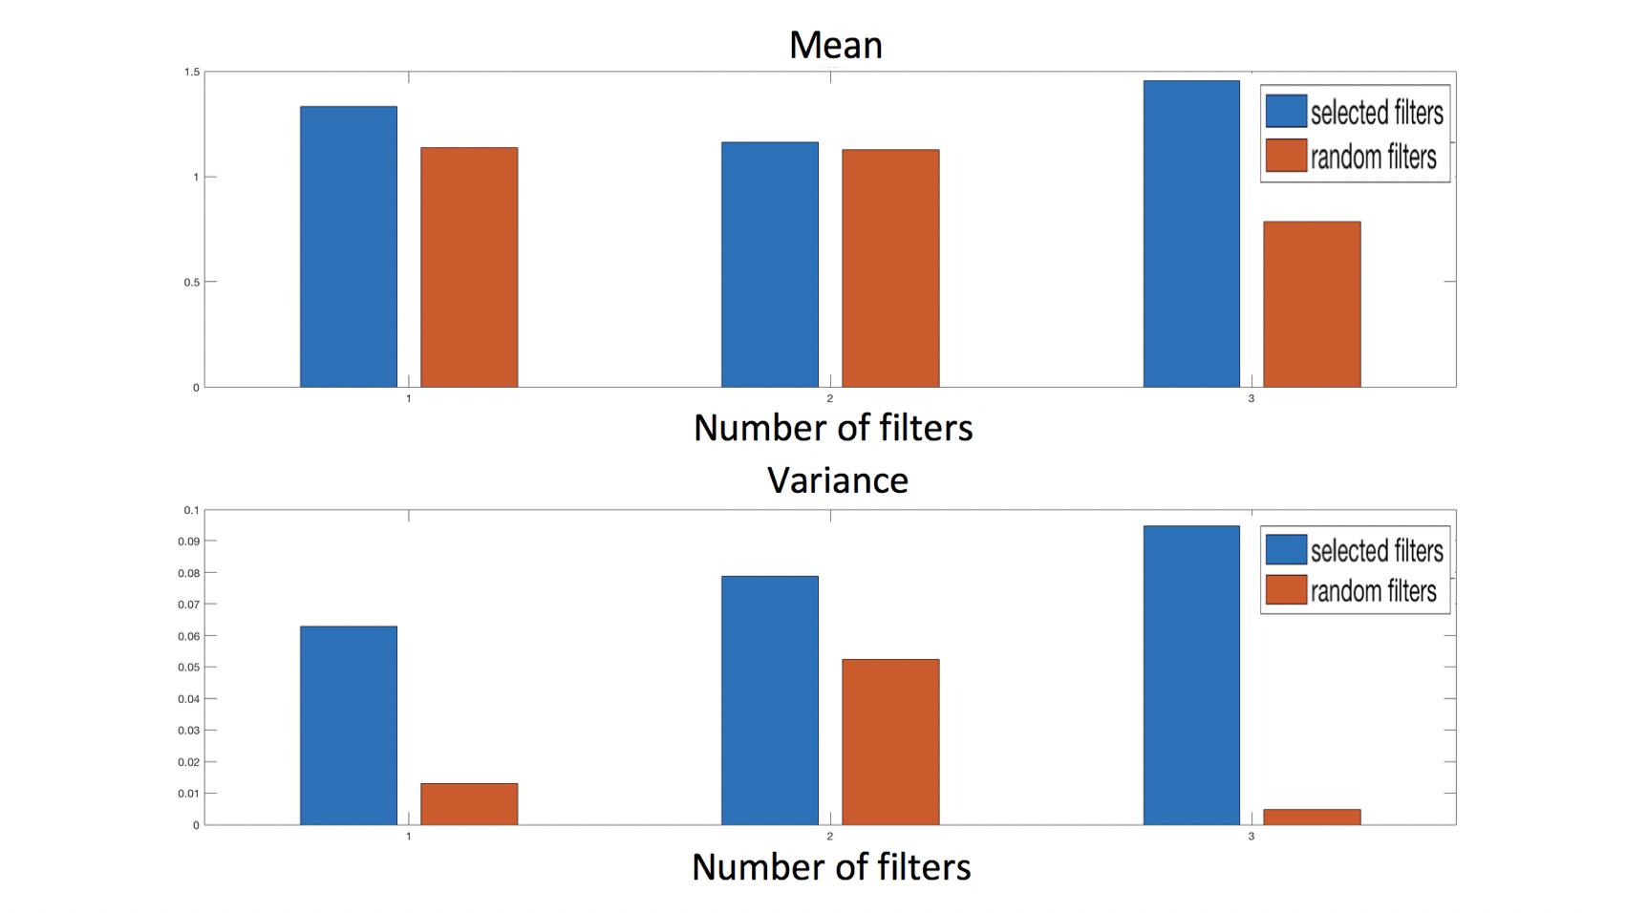
Car testing results: conv_70
Notes:
Through comparison, we can see that since the selected filters have higher variance than randomly-selected filters, the selected useful filters will be more useful in object tracking because for the various objects in the same class, the selected useful filters will give different responses to the various objects while randomly-chosen filters will give similar responses to the various objects.
The difference of the responses of selected filters is much bigger than randomly-chosen filters for the objects in the same class even if they have similar means of activation. Therefore, the selected filters can differentiate various objects in the same class better than randomly-chosen filters cannot.

Slide 19
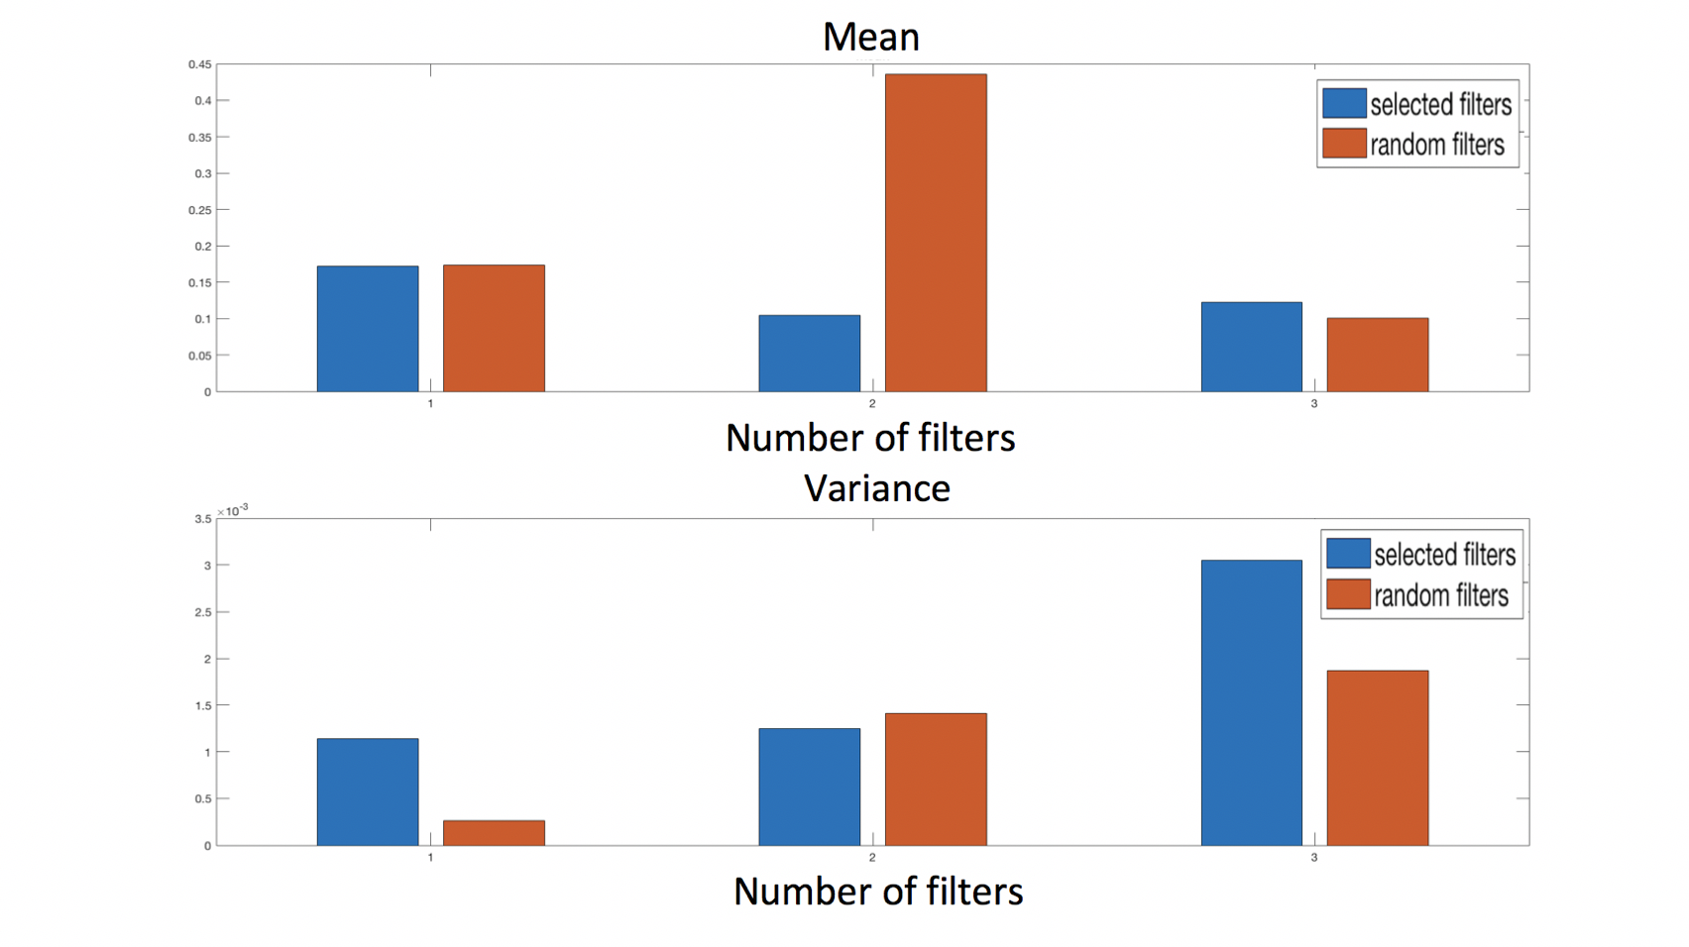
Pedestrians testing results: conv_1
Notes:
ndicates that the filter selection algorithm can select more useful filters that contain more information.

Slide 20
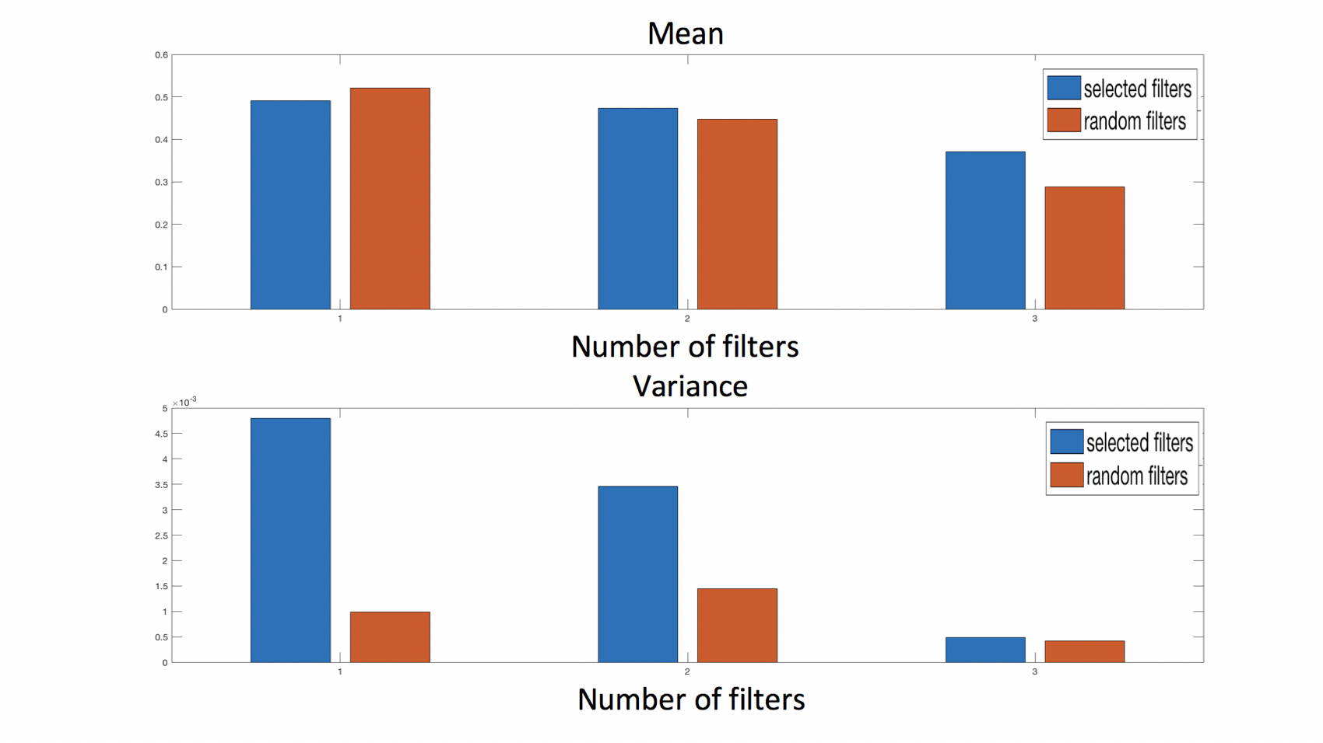
Pedestrians testing results: conv_30

Slide 21
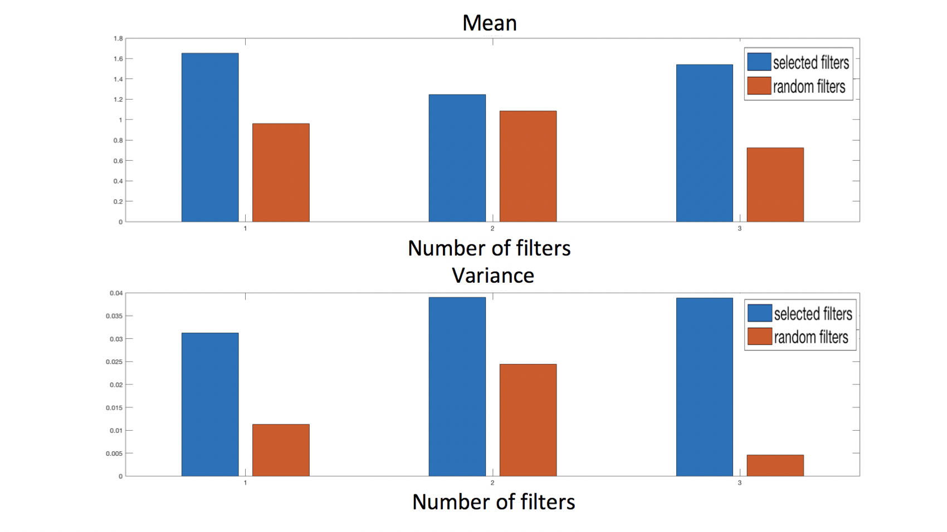
Pedestrians testing results: conv_70

Slide 22
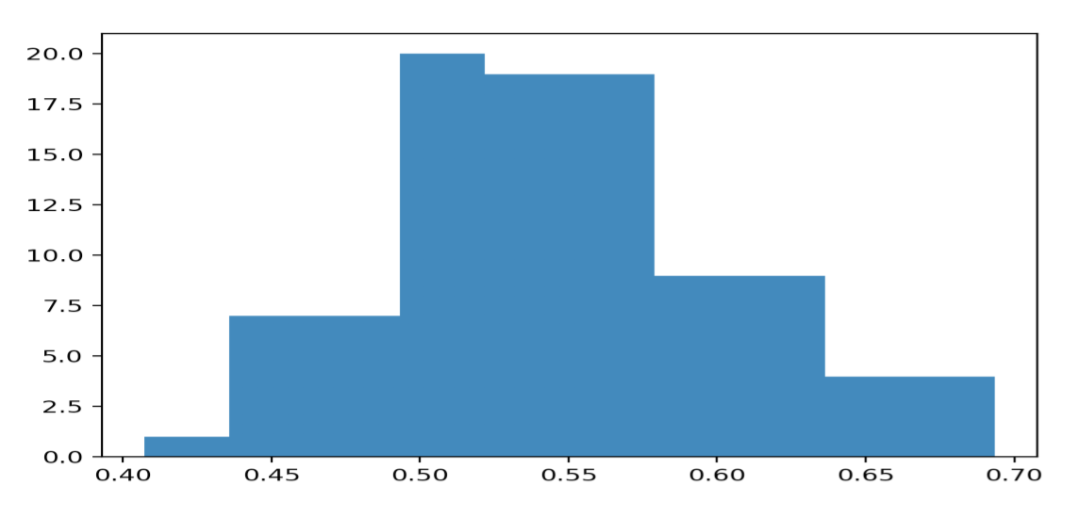
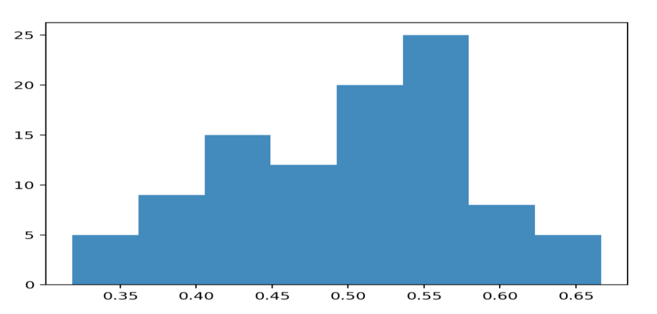
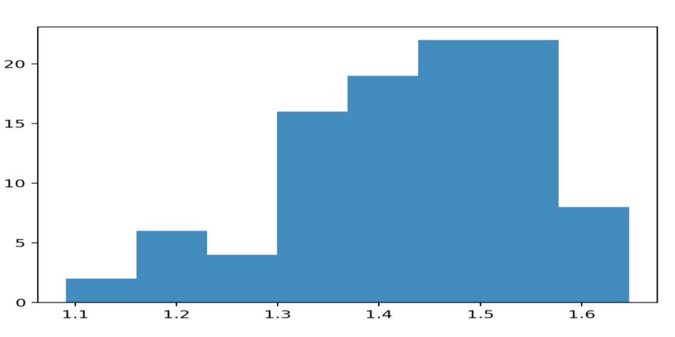
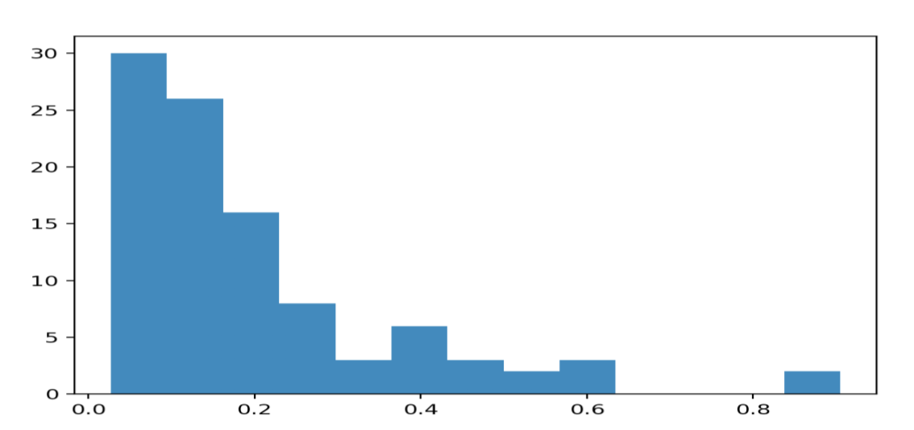
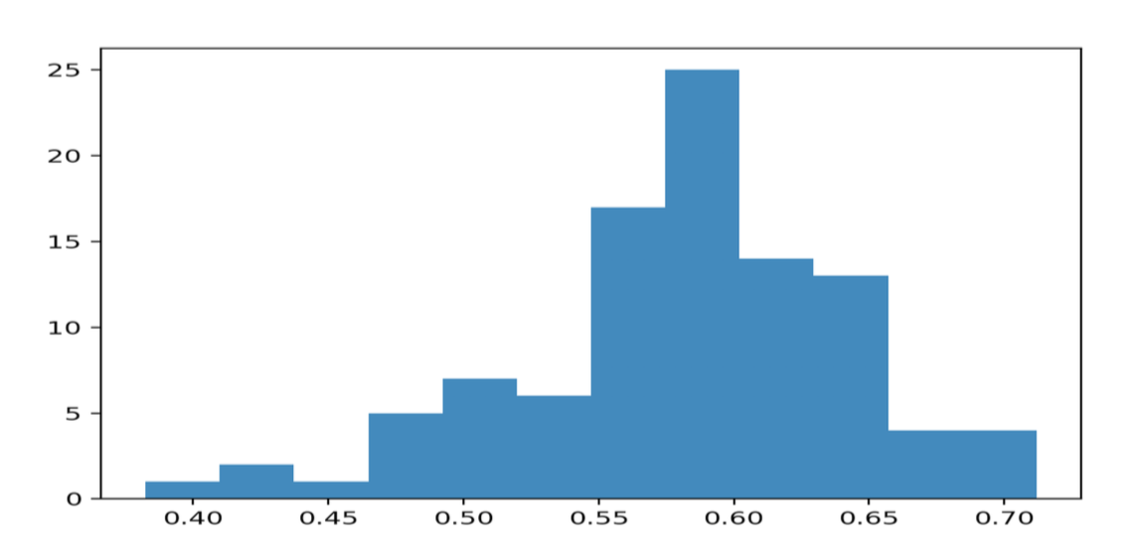
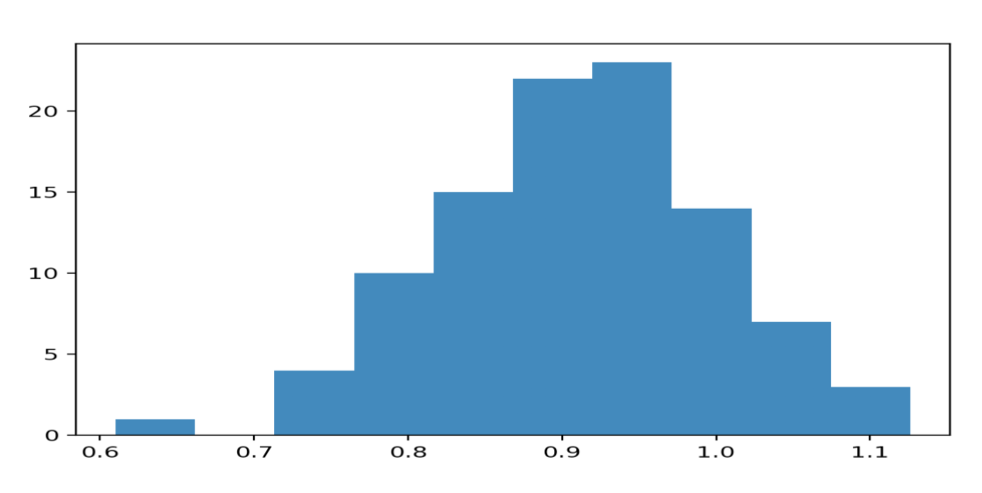
Results
Discussion
Conv_1
Conv_30
Conv_70
Filter 0
Filter 23
Notes:
However, there are also some limitations in our algorithm.
Since we use means and variances to represent the quality of filters, it is assumed that the distribution of filter activation levels on image datasets is Gaussian distribution.
But let’s look at some filters activation histogram on the 99 cropped car dataset. Here are filter 0 and 23 in layer conv_1, conv_30, conv_70 respectively. The 6 filters have 6 histograms on activation levels of the 99 cropped car dataset. 4 of them seems very typical gaussian distribution but the one on the right place of first row and the one on the left of second row cannot be considered as gaussian distribution. In such situation, the means and variances might not be the best metrics to evaluate filters.

Slide 23
Discussion
How to embed the chosen filters and make use of them in object tracking is another question to be probed
The values of means and variances can be set as features representing the objects
Another kind of combination of mean and variance can be used such as multiplication or adding the two
Only 99 images are used for filter selection and 30 images are chosen as testing, how to make the dataset larger while the calculation time is shorter
Notes:
Since we choose the filters based on variances and means, how to embed the chosen filters and make use of them in object tracking is another question to be probed
The values of means and variances can be set as features representing the filters and extra distinctive features
Another kind of combination of mean and variance can be used such as multiplication or adding the two

Slide 24

Conclusion
Filter selection algorithm is better than random selection
Means and variances can be combined as features
Using filter selection can reduce the number of features in CNNs
Good to differentiate various objects in the same class
Can be generalized to other CNNs, not restricted to YOLOv3
A general method in deep learning to extract object features

Slide 25
Questions?
Thank you!

